Slide 1
Wastewater Treatment

Slide 2
What is wastewater treatment
Usually refer to sewage treatment, or domestic wastewater treatment
process of removing contaminants from wastewater, both runoff and domestic
Two types of waste water
1. Domestic Sewage
2. Industrial Sewage

Slide 3
Where does wastewater come from? (Source)
Residences
Commercial institution
Industrial institution (usually require specialized treatment process)

Slide 4
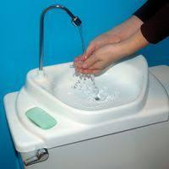
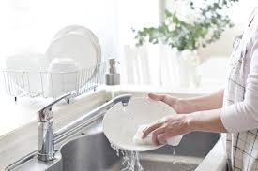
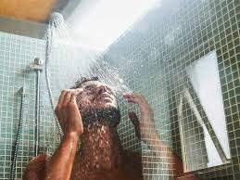
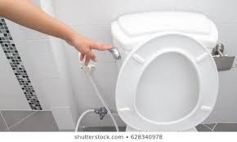
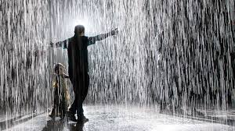
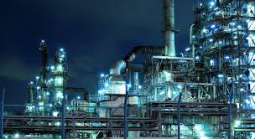

Slide 5
Sewage is primarily the liquid waste but usually gets mixed with industrial wastes, ground water and storm water.
Sewage contain so many different substances, both suspended and dissolved matter such as food waste, oil, soaps dirt, rags paper, sand grains, human and animal waste or excreta.
The total amount of organic materials is related to the strength of the sewage. This is measured by the BOD.
Another important parameter related to the strength of the sewage is Total Suspended Solids (TSS).
Sanitary sewage contains BOD 200 mg/l
TSS of about 240 mg/L

Slide 6
Waste water or sewage treatment
Objectives
1. To eliminate hardness of water
2. To eliminate the bad smell
3. To remove the solid wastes in the sewages
4. To kill and remove the disease producing
micro organisms.
The basic purpose of sewage treatment is to destroy pathogenic microorganism and to remove most suspended and dissolved biodegradable organic materials. It is also necessary to recover precious water for recycling.

Slide 7
Targets
To produce waste stream (effluent)
To produce solid waste (sludge)
To discharge or reuse them back into the environment

Slide 8
How can it be treated?
collected and transported via a network of pipes and pump stations to a municipal treatment plant

Slide 9
Types of treatment
Mechanical treatment
  Influx (Influent)
  Removal of large objects
  Removal of sand and grit
  Primary Sedimentation
Biological treatment
  Trickling bed filter
  Activated sludge
Chemical treatment
  Disinfection

Slide 10
Steps involved in waste water treatment
Preliminary treatment
Primary treatment
Secondary treatment
Tertiary treatment
Sludge digestion

Slide 11
Preliminary treatment
Solids and suspended impurities are removed by passing the waste water through bar and mesh screens
Screening: Bar or mesh screens hold floating debris, bulky objects, etc. that could block pipes or damage mechanical equipment in the rest of the water treatment plant.
Grit Removal: A grit chamber where small particles like sand, stones, etc. are allowed to settle.

Slide 12
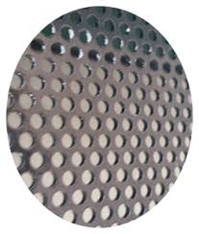
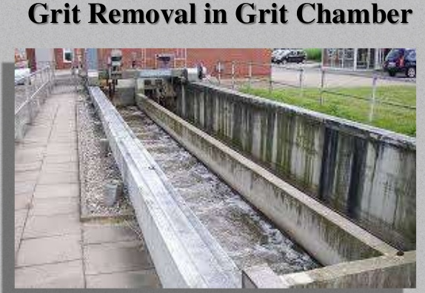

Slide 13
Preliminary Treatment
Racked screen
Remove large objects
Ex: sticks, rags and toilet paper
Avoid blocking equipment in sewage treatment plant
The Racked Screen is perfectly suited to both municipal and industrial wastewater and process water screening. The cleaning elements, attached to the chain system, can easily be adjusted to suit different requirements.

Slide 14
Primary treatment
-Solids are separated
Suspended organic solids are removed by sedimentation in primary treatment.
Sludge that settles down is removed and oil/grease is skimmed off from the top.
Coagulants are added to remove tiny particles.
About 60% of suspended solids and 30% of organic materials are removed.

Slide 15
Treatment stages - Primary treatment
typical materials that are removed during primary treatment include
  fats, oils, and greases
  sand, stones and rocks
  larger settleable solids including human waste, and floating materials

Slide 16
Methods used in primary treatment
Sand catcher
  Remove sand, stones and grit
  Control wastewater velocity
    Sand grit and stone settle
    Keep suspended organic matter in water
  Prevent the damage equipment in the remaining treatment stage
  Landfill

Slide 17
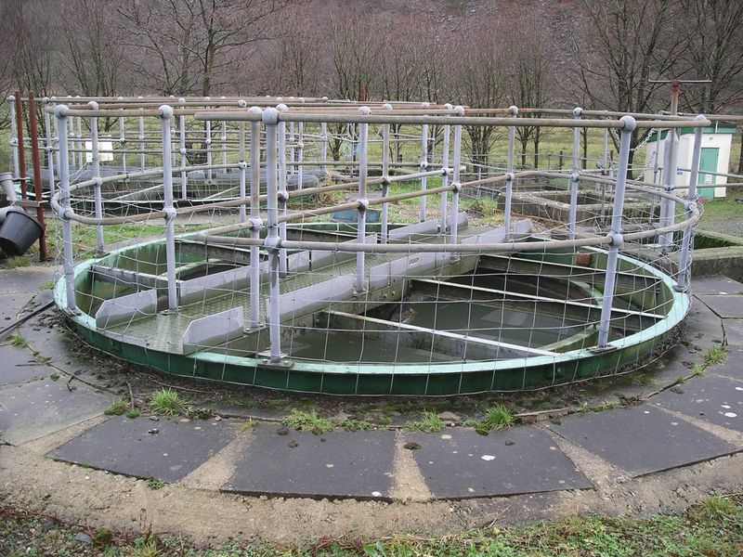
Primary Sedimentation Tank
  Remove grease, oil
  Fecal solid settle, floating material rise to the surface
  Produce a homologous liquid for later biological treatment
  Fecal sludge are pumped to sludge treatment plant

Slide 18
Secondary treatment
  Dissolved biological matter is converted into a solid mass by using water-borne bacteria
  95% of the suspended molecules should be remove
Fine suspended particles and dissolved organic matter are removed.
Biological treatment involves the use of microorganisms.
Bacteria and protozoa consume the organic pollutants as food and convert them to CO₂, H₂O and energy. This process requires oxygen

Slide 19
Treatment stages - Secondary treatment
Degrade biological content (dissolved organic matter) of the sewage
  Ex: human waste, food waste, soaps, detergent
Added bacteria and protozoa into sewage
3 different approaches
  Fixed film system
  Suspended film system
  Lagoon system

Slide 20
Fixed Film Systems
  grow microorganisms on substrates such as rocks, sand or plastic
  wastewater is spread over the substrate
  Ex: Trickling filters, rotating biological contactors

Slide 21
Secondary treatment methods
Two of the most common biological
treatment systems are
Trickling filter
Activated Sludge
These remove about 85% Biological oxygen demanding waste and TSS.

Slide 22
TRICKLING FILTER PROCESS
1. It is a circular tank.
2. Sewage is sprayed over crushed rocks
3. Slow rotating arm sprayer is used.
4 . When sewage moves downwards microorganisms
grow on rocks surface.
5. Food for the microorganisms is organic matters in
sewage.
6. After aerobic oxidation sewage goes to settling tank
7. In settling tank sludge are removed.
8. By this process 85% of BOD removed.

Slide 23
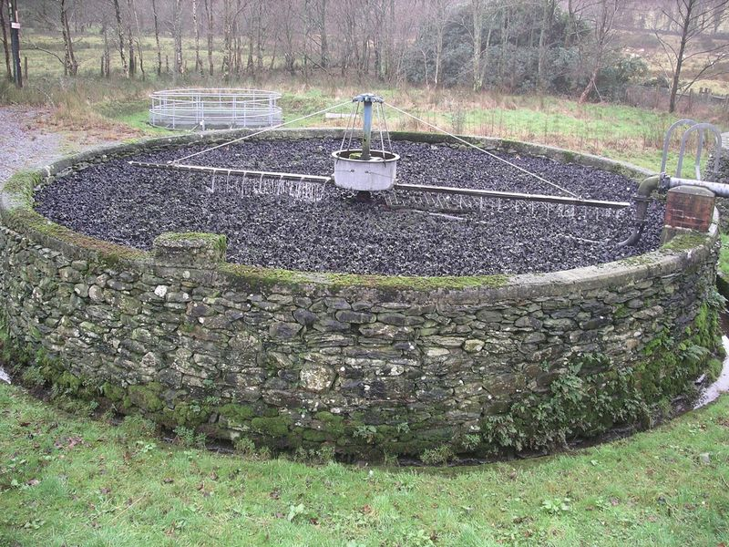
Trickling filters bed
Spread wastewater over microorganism
made of coke (carbonised coal), limestone chips or specially fabricated plastic media
Optimize their thickness by insect or worm grazing

Slide 24
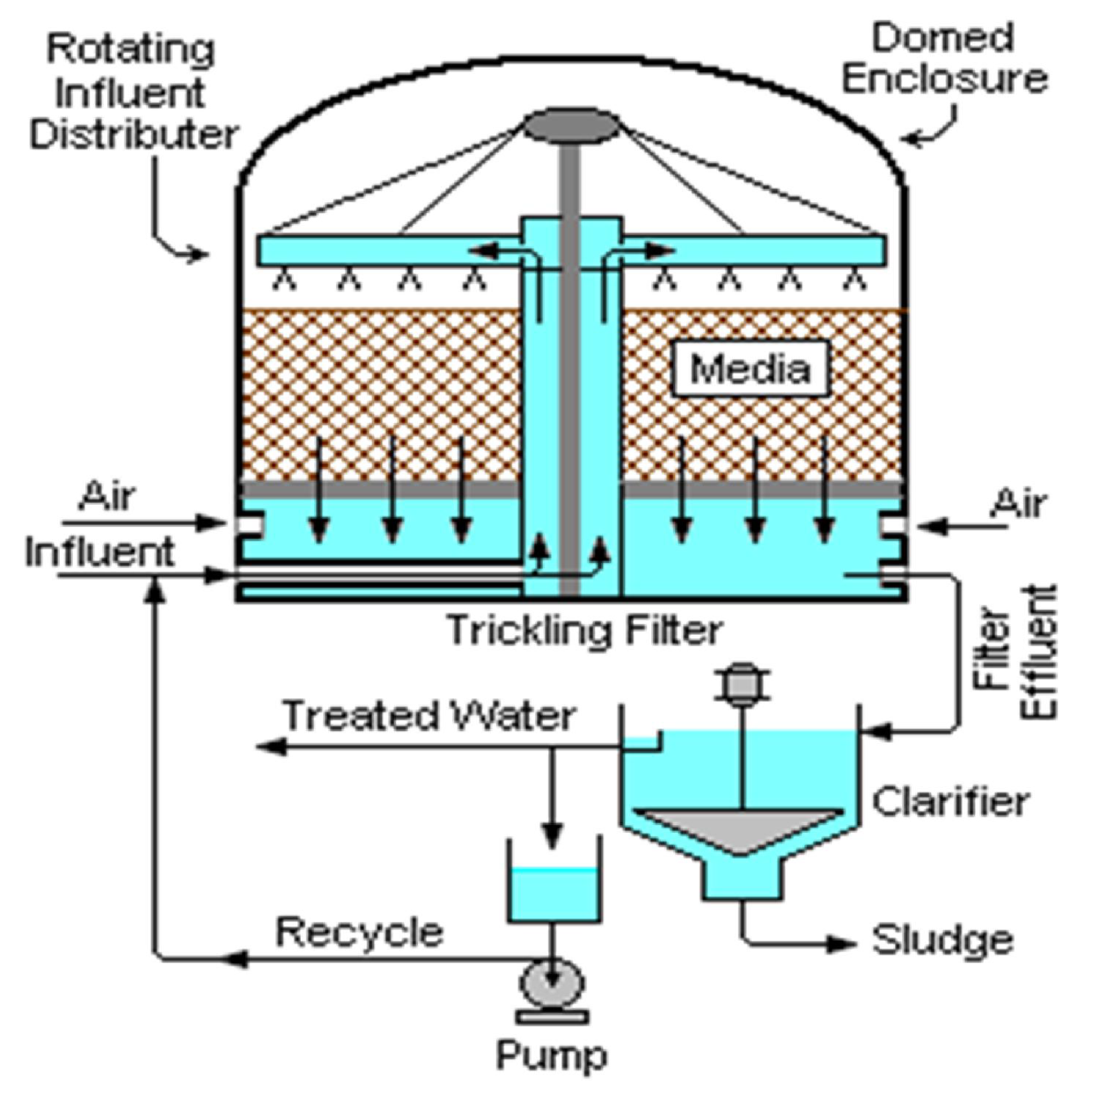
Trickling filter: The microbes remain attached to a surface while the waste water flows over them. It is a fixed growth system.

Slide 25
Suspended Film Systems
  stir and suspend microorganisms in wastewater
  settled out as a sludge
  pumped back into the incoming wastewater
  Ex: Activated sludge, extended aeration

Slide 26
Activated sludge
mixed community of microorganisms
Both aerobic and anaerobic bacteria may exist
Biological floc is formed

Slide 27
Activated sludge process
1. Activated sludge is biologically activated sewage
2. Sewage from primary treatment mixed with activated
sludge
3. It is aerated in aeration tank
4. Here oxidation of organic impurities takes place
5. Sludges settle down in the sedimentation tank.
6. This process removes 95% of BOD

Slide 28
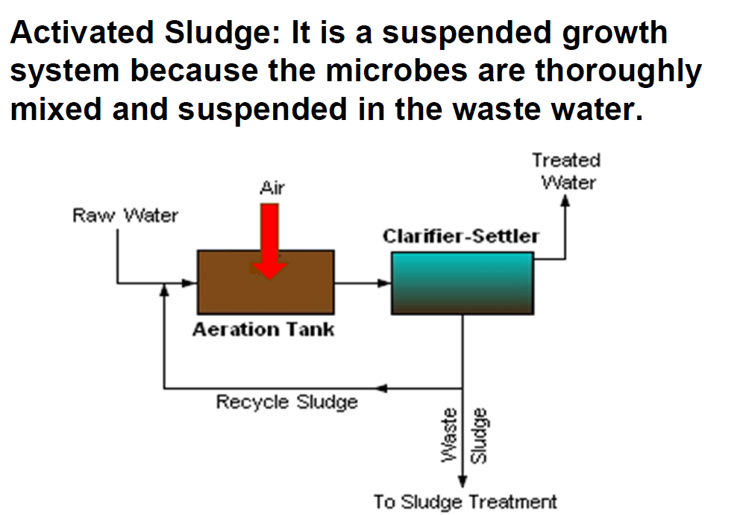

Slide 29
Tertiary treatment methods

Slide 30
Tertiary treatment methods

Slide 31
Tertiary treatment methods

Slide 32
Tertiary treatment methods

